Slide 1
CS 483/5583 Software Security
Threat Modeling

Slide 2
Agenda
What Is Modeling?
Modeling Notations
What Is Threat Modeling?
Microsoft’s Threat Modeling Approach
Bring Threat Modeling to Your Organization

Slide 3
References
Dianxiang Xu. Modern Software Engineering: Principles and Practices. 2021.
James N. Helfrich. Security for Software Engineers. 1st Edition. Chapman and Hall/CRC. September 2020.
Loren Kohnfelde. Designing Secure Software: A Guide for Developers. No Starch Press, Dec. 2021.
Adam Shostack, Threat Modeling: Designing for Security, Wiley; February 2014.
Michael Howard and David LeBlanc, D. Writing Secure Code. Chapter 4. Microsoft Press. 2nd edition, 2003.

Slide 4
Threat Modeling Tools
Microsoft Threat Modeling Tool
https://learn.microsoft.com/en-us/azure/security/develop/threat-modeling-tool
OWASP Threat Dragon
https://owasp.org/www-project-threat-dragon/
AWS ThreatComposer
https://awslabs.github.io/threat-composer/workspaces/default/dashboard
Threagile
https://threagile.io/
…

Slide 5
What Is Modeling?
The process of creating abstract, simplified description...
Helps understand the system thoroughly by teasing out what questions we should ask
Holes in the model reveal unknown or ambiguous behavior
Multiple, conflicting outputs to the same input reveal inconsistencies
As the model develops, it becomes more and more obvious what we don’t know and what the customer does not know

Slide 6
Modeling Notations
Important to have a notation for documenting and communicating decisions
Notations
Data flow diagrams (DFDs)
Finite state machines (FSMs)
Unified Modeling Language (UML)
State machines (behavior and protocol)
Use case diagrams, activity diagrams
Collaboration diagrams, class diagrams
…
Petri nets

Slide 7
Data Flow Diagrams
Model functionality and the flow of data from one function to another
Decomposition
A system can be decomposed into subsystems and subsystems can be decomposed into still lower-level subsystems
Context -> level 0 -> level 1 -> level 2

Slide 8
DFD Basic Symbols
Process: transforms or manipulates data
Multiple processes (another DFD)
Data store: a location that stores temporary or permanent data
Boundary: a machine, physical, address space or trust boundary
Interactor / actor, entity that provides input/ receives output
Data flow from data stores, processes, or interactors

Slide 9
DFDs and Decomposition
Context
Level 0
Level 1

Slide 10
DFDs: Payroll Application
Internet
Data center
2.0
Admin
Admin task request
Admin task feedback
1.0
User
Payroll info Request
0.0 Payroll Application
Payroll info response
3.0
Web developer
Updated files
4.0
Auditor
Audit entries

Slide 11
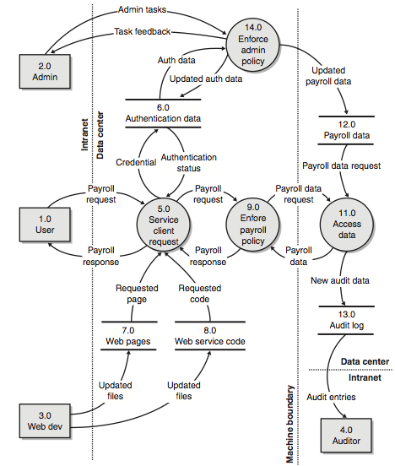
Payroll Application Level-1 DFD

Slide 12
How to Build DFDs?
Ignore the inner workings of application
Define scope, not functional details
Identify to what events or requests must the system respond
Identify what responses will the process generate
Identify the data resources as they relate to each request and response
Ascertain the recipient of each response

Slide 13
DFD Rules
A process must have at least one data flow entering or one data flow exiting
All data flows start or stop at a process
Data stores connect a process with a data flow
Data stores cannot connect together
Process names are verbs and nouns, or verb phrases
Data flow names are nouns or noun phrases
Interactor names are nouns
Data store names are nouns

Slide 14
Data Flow Diagrams – cont’d
Advantage
An intuitive model of the system's high-level functionality and the data dependencies among various processes
Easy to read and understand
Disadvantage
Can be ambiguous - different ways of interpreting multi-input/output flows
Are all inputs needed/generated or is only one of them needed/generated?

Slide 15

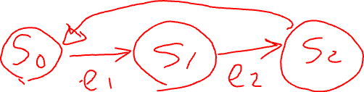
Finite State Machines
States, events, transitions, initial state
FSMs and OOP
Completeness

Slide 16
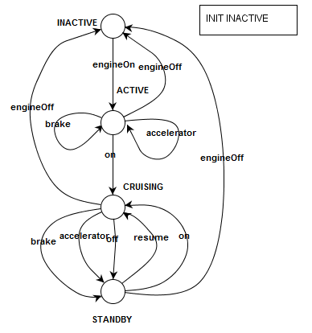
Finite State Machines: Example

Slide 17
What Is Threat Modeling?
The process of identifying, specifying, evaluating, and mitigating potential attacks.
Security features are determined after threat analysis – better than adding security features in an ad hoc and random fashion
Model functions
Determine threats
Rank threats
Mitigate threats
Notes:
What are you building?
What can go wrong?
What should you do about those things that can go wrong?
Did you do a decent job of analysis?

Slide 18
Threat Modeling: Benefits
Help you understand your application better
“Oh, so that’s how it works!”
Help you find bugs
Help you find design problems
Help new team members understand the application in detail
Can be used by other product teams that build on your product.
Are useful for testers

Slide 19
Microsoft’s Threat Modeling
Model functions
Application Decomposition + DFD
Determine threats
STRIDE
Model threats with threat trees
Rank threats
DREAD
Mitigate threats
Mark threat trees

Slide 20
Decompose Applications
Eventually, you get to the point where you understand the composition of the application
When to stop?
Just go deep enough to determine threats
Functions and threats should be modeled at the same level of abstraction
Functional modeling needs to capture the info, resources and services that can be threatened

Slide 21
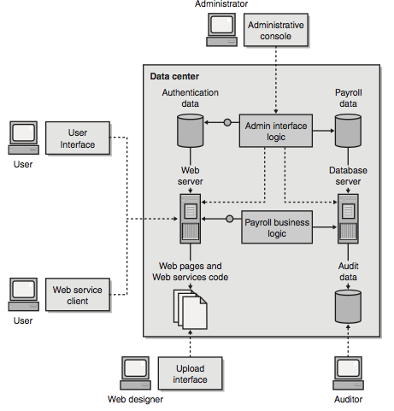
Payroll Application: Physical View

Slide 22
Payroll Application Level-1 DFD

Slide 23
Payroll Application
Component/user | Comments
User | Review payroll data, tax info
Administrator | Manage the system; cannot manage the payroll data directly; data provided by Payroll department
Web designer | Maintain the web application source code
Auditor | Review audit logs to determine suspicious activity
User interface | Html based; primary access point for users
Administrative console | Allows administrator to manage the servers and data
Upload interface | Web designers work on local copies and upload changes and code or pages

Slide 24
Payroll Application: cont’d
Component/user | Comments
Authentication data | Used to determine whether all the users are who they say they are
Payroll business logic | Takes user requests and determines the data to display to the user
Admin interface logic | Determines what is rendered on the administrative user interface. Maintains all the rules about who can do what with the data
Database server | Accesses and manipulates the payroll info and generates audit data
Payroll data | Payroll /tax info; read by the DB server
Audit data | Written by the database server

Slide 25
Determine the Threats to the System
Threat targets: components or assets
Using STRIDE
Can a nonauthorized user view the confidential data?
Can an untrusted user modify the payroll data?
Could some deny valid users service?
Could someone take advantage of the feature or component to raise their privilege to that of an administrator?

Slide 26
STRIDE
Spoofing identity
Pretend to be something or someone other than yourself
Typical victims: process, external entities, people
An attacker as Tim Cook: insecure auth.
A rogue server as a valid server: DNS spoofing
Tampering with data/process
Malicious, unauthorized data/code modification
Typical victims: data stores, data flows, processes
Notes:
Typical victims: those DFD components that are most likely to be victimized.
The Domain Name System (DNS) is the phonebook of the Internet.

Slide 27
STRIDE – cont’d
Repudiation
Users deny performing an action
Typical victims: process
“I did not order that Ferrari”
Information disclosure
Exposure of info to individuals who are not supposed to have access
Typical victims: processes, data stores, data flows

Slide 28
STRIDE – cont’d
Denial of service
Deny service to valid users
e.g., by making a web server temporarily unavailable or unusable
Typical victims: processes, data stores/flows
Elevation of privilege
An unprivileged user gains privileged access
And has sufficient access to compromise the entire system
Typical victims: processes

Slide 29
Spoofing Threats
Spoofing a process on the same machine
Spoofing a file
Spoofing a machine
IP spoofing, DNS spoofing, IP redirection
TOR project (Anonymity Online): torproject.org
Spoofing a person
Set email display name
Take over a real account
Spoofing a role
Declare to be that role

Slide 30
Tampering Threats
Tampering with a file
Tampering with memory
Modify code
Modify data
Tampering with a network
Redirect the flow of data to their machine
Modify data flowing over the network

Slide 31
Repudiation Threats
Repudiating an action
Claim to have not received
Claim to have been a fraud victim
Use someone else’s account
Attacking the logs
Notices you have no logs
Put attacks in the logs to confuse logs
Log reading code

Slide 32
STRIDE in the Context of DFDs

Slide 33
Information Disclosure Threats
Information disclosure against a process
Extract secrets from error messages
Reverse engineering
Information disclosure against a data store
Take advantage of inappropriate access control
Find files protected by obscurity
Find crypto keys on disk or in memory
Get data from logs or temp files
Get data from swap storage
Read files as they traverse the network
Information disclosure against a data flow
Learn secrets by analyzing traffic
Learn who’s talking to whom by watching the DNS

Slide 34
DoS Threats
DoS against a process
Absorb memory
Absorb CPU
Create unhandled exceptions
DoS against a data store
Fill data store up
Make enough requests to shut down the system
DoS against a data flow
Consume network resources

Slide 35
Elevation of Privilege Threats
EoP against a process by corrupting the process
Send inputs that the code does not handle properly
Gain access to read/write memory
Elevation through missed authorization checks
Elevation through buggy authorization checks
Elevation through data tampering
e.g., Configuration

Slide 36
Relating DFDs and STRIDE
Threat Type | Affects Processes | Affects Data Stores | Affect Data flows | Affects Interactors
Spoofing | Y |  |  | Y
Tampering | Y | Y | Y
Repudiation | Y | Y |  | Y
Info disclosure | Y | Y | Y
Denial of service | Y | Y | Y
Elevation of privilege | Y

Slide 37
STRIDE vs. Security Goals/Means
Spoofing
Authentication
Tampering with data/code
Integrity, authorization
Repudiation
Information disclosure
Confidentiality
Denial of service
Availability
Elevation of privilege
Authorization

Slide 38
Elevation of Privilege (EoP) Card Game
Helps clarify the details of threat modeling and examines possible threats to software and computer systems.
EoP focuses on the STRIDE threats
EoP uses a simple point system that allows you to challenge other developers and become your opponent's biggest threat

Slide 39
The EoP Game: 6 Suites/74 Cards
Spoofing: 2 – A, 13 cards
2. An attacker could squat on the random port or socket that the server normally uses
Tampering: 3-A, 12 cards
4. Your code makes access control decisions all over the place, rather than with a security kernel
Repudiation: 2-A, 13 cards
Information disclosure: 2-A, 13 cards
Denial of Service: 2-A, 13 cards
Elevation of Privilege: 5-A, 10 cards
File: EoP_Card Game Images.pdf

Slide 40
Determine Threats – cont’d
Threat types can interrelate
Info disclosure may lead to spoofing if the user’s credentials are not secured
Spoofing may lead to a situation where escalation is no longer needed
STRIDE is an effect classification
Categorize vulnerabilities according to their cause
Other threat analysis
CMU SEI: Operationally Critical Threat, Asset, and Vulnerability Evaluation (OCTAVE)

Slide 41
Threat Trees
The decision-making process an attacker would go through to compromise the system
Once a threat is identified, determine how it could manifest itself by using threat trees
Payroll application
Payroll data flow between the user and the computer in the data center
Info disclosure: a malicious user looking at someone else’s payroll info
Network protocol analyzer sniffer
Compromise a router between the computers

Slide 42
View Sensitive Payroll Data
Threat #1 Attacker
views sensitive payroll data on the wire (I)
AND
1.1 HTTP traffic is unprotected
1.2 Attacker views traffic
OR
1.2.1 Uses sniffer
1.2.2 Listens to router traffic
1.2.3 Compromises switch
AND
OR
1.2.2.1 Router unprotected
1.2.2.2 Compromises router
1.2.2.3 Guesses router password

Slide 43
Threat Trees – cont’d
Root: ultimate attack goal
Intermediate non-leaf nodes
Sub-goals of parent node
Relation between siblings: AND/OR
Leaf node: primitive attack conditions/actions
Attack path
A sequence of leaf nodes that achieve the ultimate attack goal of the root node
<1.1, 1.2.1>
<1.1, 1.2.2.1, 1.2.2.2>

Slide 44
Outline Representation of Trees
1.0 View sensitive payroll data on the wire
1.1 HTTP traffic is unprotected (AND)
1.2 Attacker views traffic
1.2.1 Uses sniff
1.2.2 Listen router traffic
1.2.2.1 Router is unprotected (AND)
1.2.2.2 Compromise router
1.2.2.3 Guess router password
1.2.3 Compromise router

Slide 45
Small Enhancements
Use dotted lines to show the least likely attack points
Use solid lines for the most likely
Place circles below the least likely nodes why the threat is mitigated

Slide 46
Enhanced Tree: Example
Gain user’s pswd info (I)->(S)->(E)
1.1 Snoop auth connection
1.2 Compromise credential store
1.3 Read local user’s pswd
Using SSL/TLS
Need physical access to server
1.3.1 Virus to read pswd
1.3.2 install malicious code
Need physical access to computer

Slide 47
Items to Note
Item | Comments
Title | The threat should be obvious. Be reasonably descriptive but don’t say too much
Threat target | Which part of the application? Data store, data flow, and process?
Types | A threat can fall under multiple types
Risk | Use a consistent method
Threat trees | Keep the trees simple; going too deep could get you lost
Mitigation status & techniques | Yes, no, somewhat, needs investigating; Specific techniques

Slide 48
Rank the Threats: Risk Assessment
Simple method
Risk = criticality * likelihood of occurrence
1: low; 10 high
Using DREAD
Damage potential
0 = Nothing; 5 = Individual user data is compromised or affected; 10 = Complete system or data destruction
Elevation of privilege threats are usually a 10

Slide 49
DREAD – cont’d
Reproducibility
How easy it is to reproduce the threat exploit
0 = Very hard or impossible
5 = One or two steps required.
10 = so easy (e.g., just a web browser and the address bar is sufficient)
Exploitability
How much effort/expertise to mount an attack?
0 = Advanced knowledge, with attack tools.
5 = Malware exists on the Internet, or an exploit is easily performed, using available attack tools.
10 = so easy (e.g., just a web browser)

Slide 50
DREAD – cont’d
Affected users
How many users will be affected
0 = None; 5 = Some users, but not all; 10 = All
Discoverability
How easy is it to discover this threat
DREAD rating
Averaging the numbers
9 is a serious issue; should be addressed asap
Note: the DREAD ratings are not very consistent and are subject to debate.
Sort all threats in descending order

Slide 51
DREAD Example
Threat Description: malicious user views sensitive data on the wire
Threat Target: payroll response (5.0->1.0)
Threat Category: Information disclosure
Risk: Damage potential: 8
Reproducibility: 10
Exploitability: 7
Affected users: 10
Discoverability: 10
Overall: 9
Comments: most likely from rogue user using sniff; cheap in terms of time, effort, and money,…

Slide 52
Respond to the Threats: Options
Do nothing?
Inform the user of the threat
Let user decide whether to use some feature
Example: dialog for basic authentication or SSL
Remove the problem
Pull the feature from the product
Fix the problem
Use mitigation techniques

Slide 53
Mitigate Threats
Threat type | Mitigation techniques
Spoofing | Appropriate authentication Protect secret data Don’t store secrets
Tamping with data/code | Appropriate authorization Hashes Message authentication codes Digital signatures Tamper-resistant protocols (e.g., SSL)
Repudiation | Digital signatures Audit trails (logging)

Slide 54
Mitigate Threats – cont’d
Threat type | Mitigation techniques
Info disclosure | Authorization Privacy-enhanced protocols (e.g., SSL) Encryption Protect secrets Don’t store secrets
Denial of service | Appropriate authentication Appropriate authorization Filtering (inspecting data packets) Throttling (limiting the # of requests) Quality of service
Elevation of privilege | Run with least privilege
Notes:
Quality of service is a set of components that allow you to provide preferential treatment for specific types of traffic. For example, you can allow favored treatment to streaming media traffic.

Slide 55
Apply Mitigations to Payroll
Threat/Type | Mitigation techniques
Viewing data on the wire (I) | Use SSL/TLS to encrypt Could also use IPSec
Upload rogue web pages /web service code (T) | Require strong authentication for the Web developers; Provide strong ACLs that only developers and administrators can update
Attacker denies service to application (D) | Use firewall to drop certain IP packets; restrict resources (memory, time) used by anonymous users

Slide 56
Apply Mitigations to Payroll – cont’d
Threat/Type | Mitigation techniques
Attacker manipulates payroll data (T&I) | Use SSL/TLS or DCOM/RPC to protect payroll data traffic
Elevate privilege by leveraging the service client request process (E) | Run the process using the least privilege; if it is compromised, the code cannot gain extra capabilities
Spoof Web server (S) | Use SSL/TLS to allow client software to authenticate the server,…

Slide 57
Issues
Are functions correct?
Are threats correct?
Are threats absent? or are mitigations correct?

Slide 58
Bring TM to Your Organization
How to Introduce Threat Modeling?
Threat Modeling and Project Management
Threat Modeling within a Development Life Cycle
Overcome Objections to Threat Modeling

Slide 59
How to Introduce Threat Modeling
Sales lessons
Who can sign the check and who can say no
Organizational win and personal win
Who signs off ?
Probably someone like VP of R&D who could require that no code goes out the door without a threat model
Why will your VP sign off?
Fewer bugs?
More secure products?
Fewer schedule changes due to fixing bugs late?
What will their personal win be?

Slide 60
How to Introduce TM- cont
Convincing Individual Contributors
Are you the only person who wants the team to do it?
Start with fun? the Elevation of Privilege game, bringing pizza and beer rarely hurts.
Key: identify the value your team will receive
Having a respected engineer as the champion can be a tremendous help
Convincing management
Management is about bring people together to accomplish a task – can say no to good ideas
Need a plan with “proof points” aligned with management’s expectations
What to do, resources required, what value to bring –

Slide 61
TM and Project Management
Participants: who is involved?
Tasks: what do they do?
Training: how do we help them do it?
Prep work: what needs to be done before a kick-off?
Help: what do they do when confused?
Conflict management: who makes a call when different participants disagree and cann’t reach a consensus?
Deliverables: what do the people produce?
Milestones: when are deliverables due?
Interaction: how does communication occur? In-person meetings, e-mail, wikis?

Slide 62
TM in Development Life Cycle
Waterfall
Requirements, design, testing
Gates / Definition Of Done, such as “we can’t exit the design phase until …”
“We cannot exit design without a completed model for threat identification, such as DFD”
“We can’t start coding until threat enumeration is complete”
Each mitigation is complete when there is a feature spec to cover the mitigation
Agile Development
User stories – misuse stories
Test-driven – carefully consider tests before writing code

Slide 63
TM in Development Life Cycle
Testing and Threat Modeling
The testing mindset “how can this break” overlaps with threat modeling
Finding important bugs can increase the importance of testing - testers often feel their work is not valued
Threat modeling drives security test planning
Measuring threat modeling
Number of diagrams, LOC: meaningless
Coverage of function models and STRIDE?
Checklist: e.g., four elements
Does the threat have text? Does the mitigation have text? Is the threat marked complete? Is there a bug?

Slide 64
Overcome Objections in TM
Resource objections
Too many people?
Too much work per person?
“YAGNI: You ain’t gonna need it”
Value objections
“I’ve tried threat modeling”: low value for the investment
We don’t fix those bugs: the TM approach produces many bugs
“No one would even do that”
Objections to the plan
Timing
Change of the behavior of individuals and an organization
Notes:
When you explain what to do, what resources are required, and what value is expected to bring, many valid objections can be raised against each of these.
It is important to consider and handle these objections as you develop a plan.

Slide 65
Summary
Functional modeling vs. threat modeling
Mitigation techniques reduce security risks.
This does not mean that the system will be 100% secure.
Mitigating all threats is often beyond the availability of required resources.
Threat modeling is often iterative. Stop when:
The level of security has become acceptable
The unmitigated threats are sufficiently expensive for an adversary to accomplish
Threat models for security testing

